Slide 1
Chapter 6.2 Code Refactoring (Bad Smells)
CCSW 325 (Software Construction)
Notes:
Last Update: 22/8/2019
Version 1.0

Slide 2
Outline
Simplifying Conditional Expressions
Decompose Conditional
Consolidate Conditional Expression

Slide 3

Simplifying Conditional Expression – Decompose Conditional
You have a complicated conditional (if-then-else) statement.
Extract methods from the condition, then part, and else parts.

Slide 4
Simplifying Conditional Expression – Decompose Conditional
Motivation
As with any large block of code, you can make your intention clearer by decomposing it and replacing chunks of code with a method call named after the intention of that block of code.
With conditions you can receive further benefit by doing this for the conditional part and each of the alternatives.
This way you highlight the condition and make it clearly what you are branching on.
You also highlight the reason for the branching.

Slide 5

Simplifying Conditional Expression – Decompose Conditional
Mechanics
Extract the condition into its own method.
Extract the then part and the else part into their own methods.

Slide 6
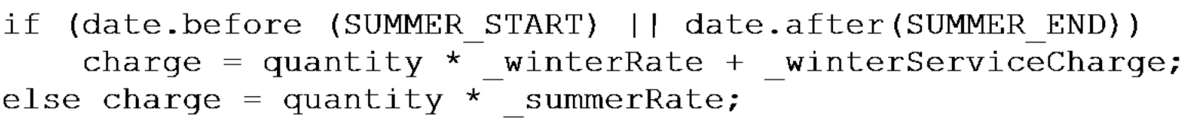
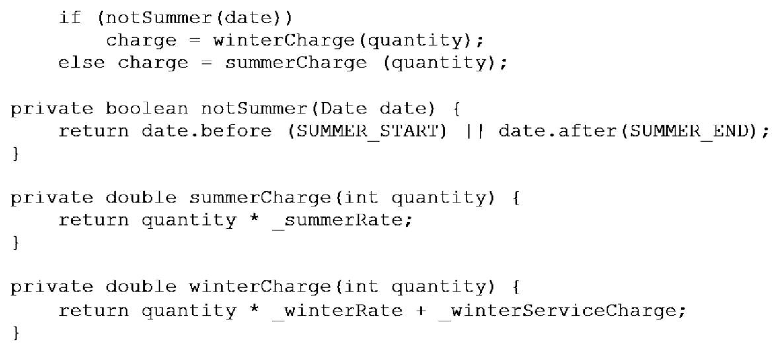
Simplifying Conditional Expression – Decompose Conditional

Slide 7
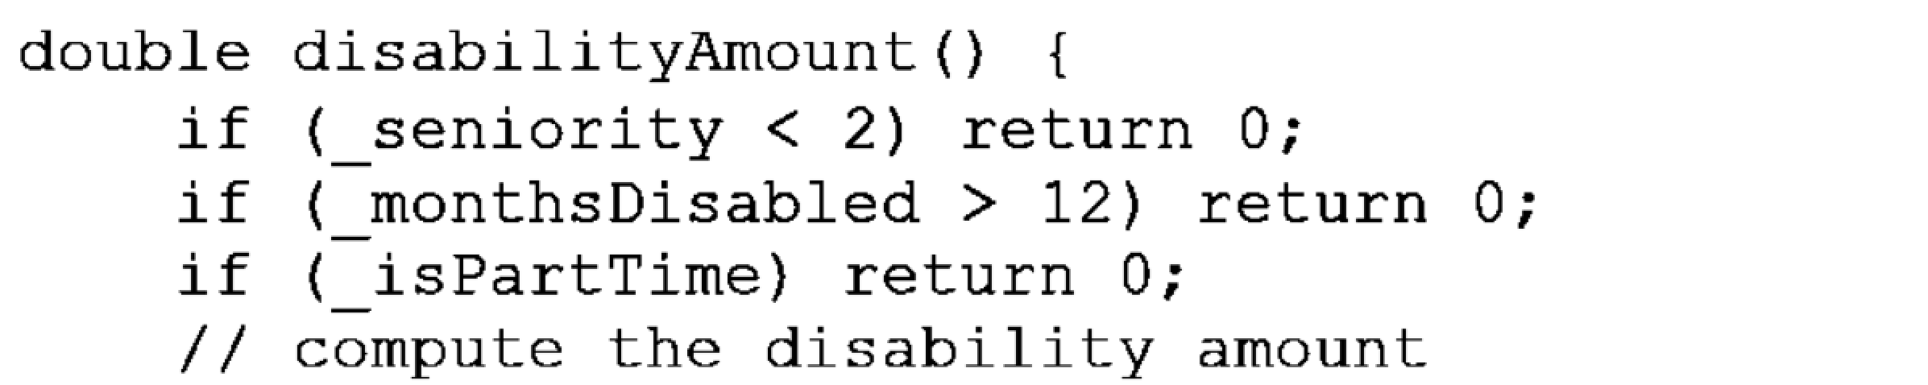
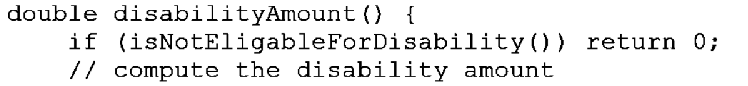
Simplifying Conditional Expression – Consolidate Conditional Expression
You have a sequence of conditional tests with the same result.
Combine them into a single conditional expression and extract it.

Slide 8
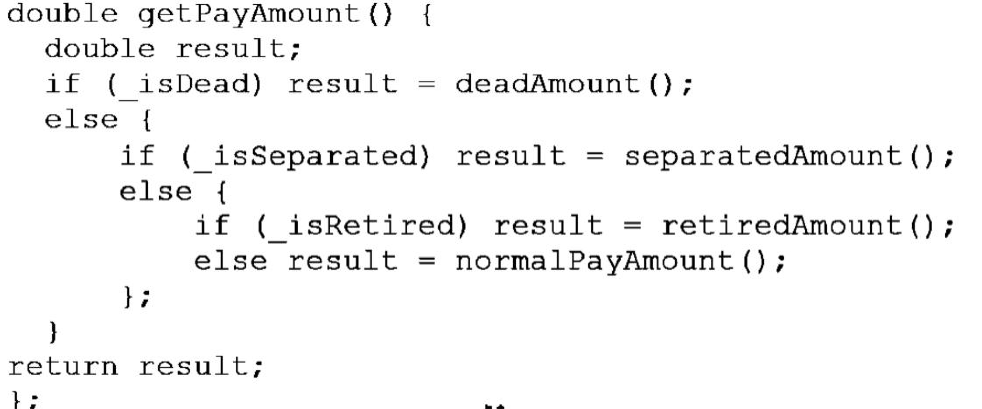
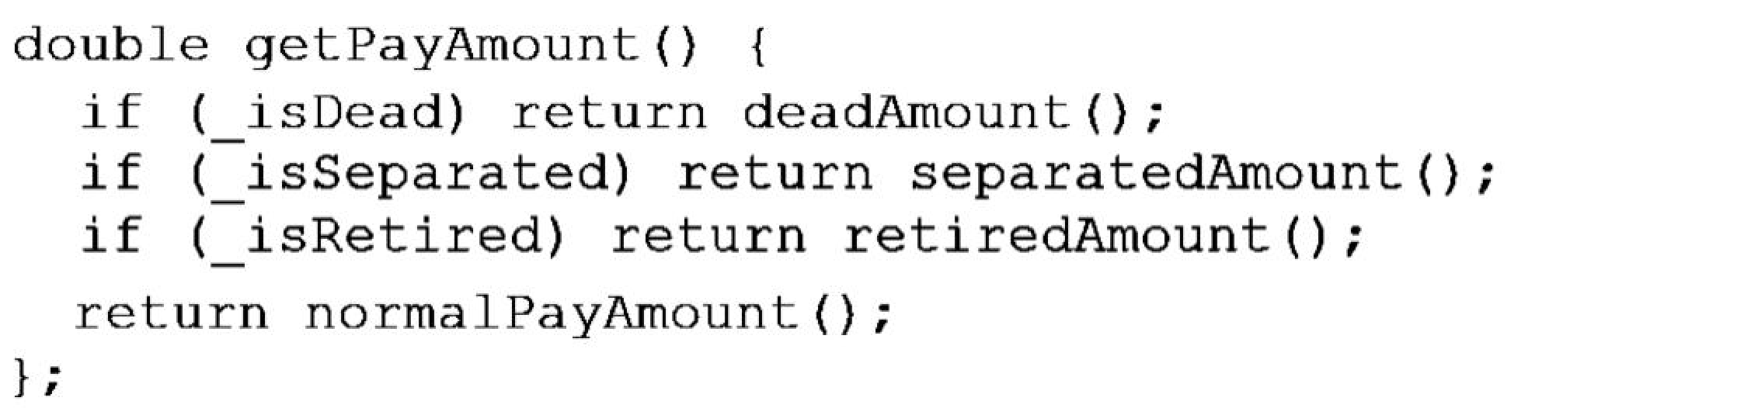
Simplifying Conditional Expression – Consolidate Conditional Expression

Slide 9
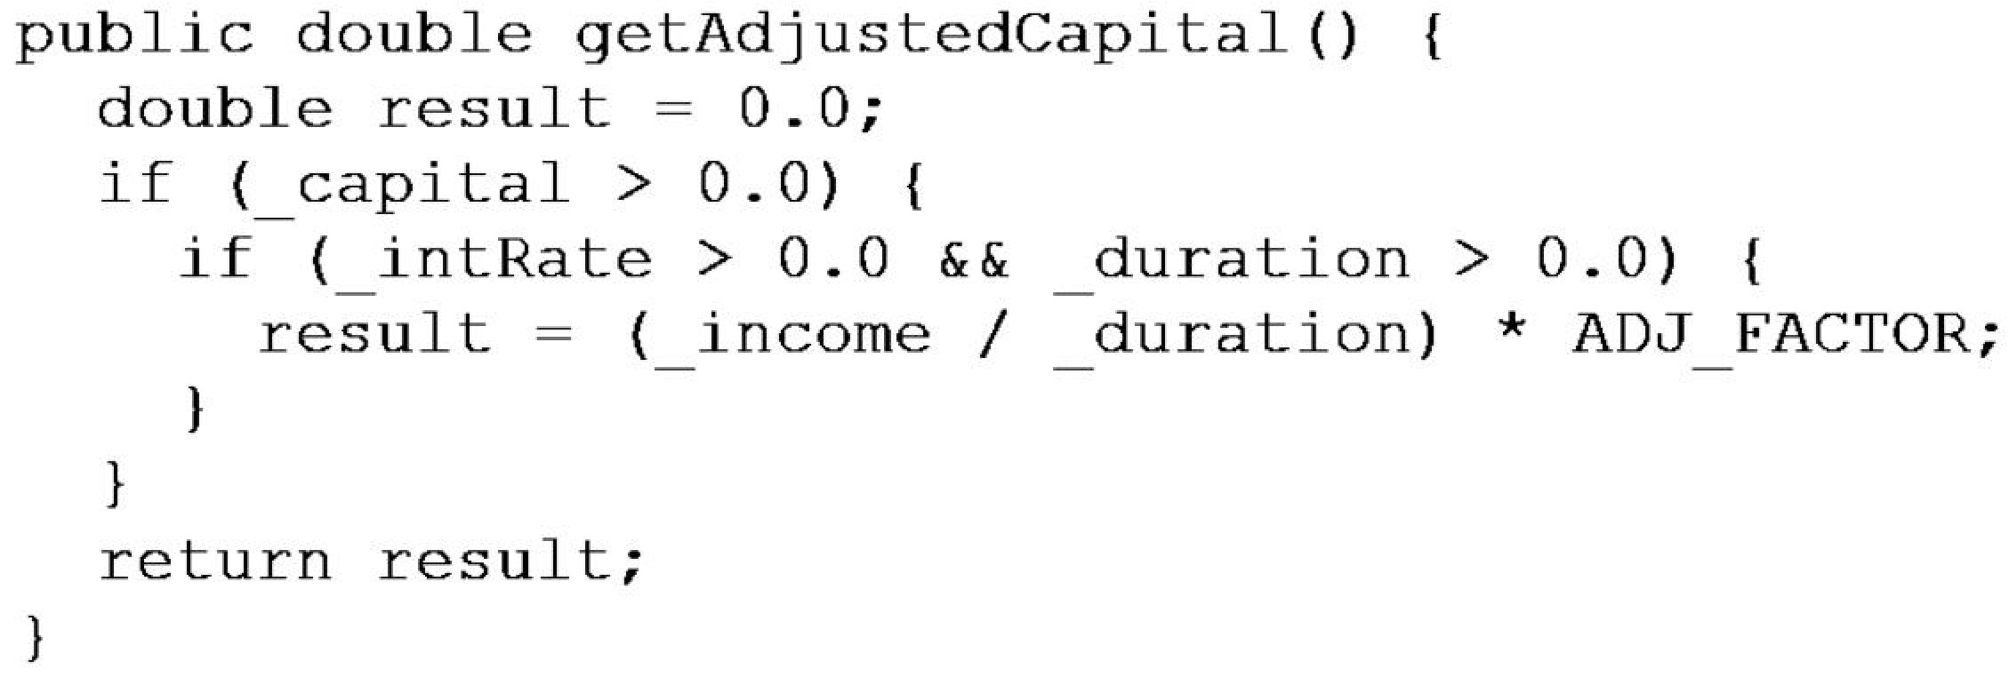
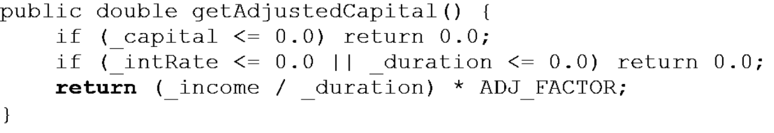
Simplifying Conditional Expression – Consolidate Conditional Expression

Slide 10
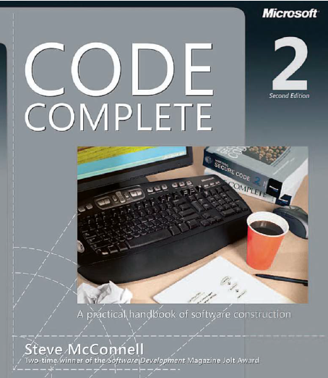
Reading
Code Complete: A Practical Handbook of Software Construction, 2nd Edition, Steve McConnell.
Chapter 26

Slide 11

Any questions? ​
Please feel free to raise your hands and ask.

